Slide 1




ASP.NET Core Razor Engine
Advanced Syntax, Controls/Helpers,
ModelBinding & Data Validation,
View Components
C# MVC
Frameworks
SoftUni Team
Technical Trainers
Software University
http://softuni.bg

Slide 2
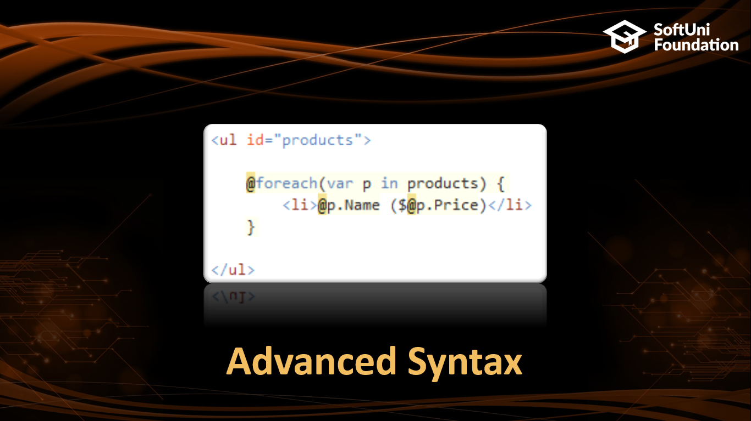



Table of Contents

Slide 3
Questions
sli.do #csharp-web

Slide 4
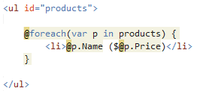
Advanced Syntax

Slide 5


Models
Controllers can pass strongly typed model to the View
Models allow IntelliSense support in the View
@model IEnumerable<Product>
<ul>
@foreach (Product p in Model)
{
<li>@p.Name</li>
}
</ul>

Slide 6

Dependency Injection
Injecting services in View
public void ConfigureServices(IServiceCollection services)
{
services.AddTransient<IStatisticsService, StatisticsService>();
}
@using Services.Contracts
@inject IStatisticsService Statistics
<h2>Sales count - @Statistics.TotalSales()</h2>

Slide 7

ViewBag
Allows us to pass data to the corresponding View
ViewBag is dynamic
public IActionResult Example()
{
ViewBag.Name = "Pesho";
return View();
}
<h1>Hello, my name is @ViewBag.Name</h1>

Slide 8

ViewData
It’s just like ViewBag but it’s not dynamic
public IActionResult Example()
{
ViewBag["Name"] = "Pesho";
return View();
}
<h1>Hello, my name is @ViewBag["Name"]</h1>

Slide 9

TempData
Allows us to store data for a redirect
public IActionResult Redirect()
{
TempData["data"] = "sampledata";
return RedirectToAction("Index");
}
public IActionResult Index()
{
var data = TempData["data"];
...
}

Slide 10

HttpContext
Razor allows access to HttpContext in View
@if (Context.User.Identity.IsAuthenticated)
{
<h1>Hello @Context.User.Identity.Name!</h1>
}
else
{
<h1>Hello Guest!</h1>
}

Slide 11

Controls/Helpers

Slide 12
View Helpers
Each view inherits RazorPage
ViewPage has a property named Html
Html property has methods that return string and can be used to generate HTML
Create inputs
Create links
Create forms
@using (Html.BeginForm("Index", "Home", FormMethod.Post))
{
@Html.TextBox("username")
<input type="submit"/>
}

Slide 13

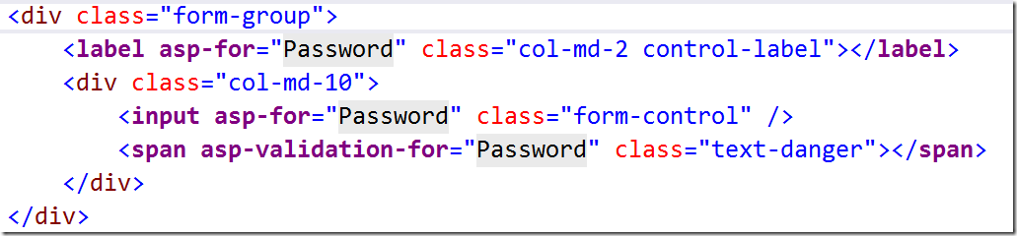
Tag Helpers
Allow us to create HTML elements with code
<label asp-for="Email"></label>
<label for="Email">Email</label>
Helpers

Slide 14
Common HTML Helpers
HTML Helper | Description
@HTML.ActionLink | Returns and anchor link
@using (Html.BeginForm) { form content } | Creates and html form
@HTML.CheckBoxFor | Creates a checkbox for a given property of the model
@HTML.Display\For | Displays the name of a given property
@HTML.Editor\For | Creates and editor\for a given property
@HTML.Label\For | Creates a label\for the given property

Slide 15
Other HTML Form Helpers
HTML Helper
@Html.DropDownList\For
@Html.TextBox\For
@Html.TextArea\For
@Html.Password\For
@Html.Hidden\For
@Html.CheckBox\For
@Html.RadioButton\For
@Html.ListBox\For

Slide 16

Custom Helpers
Write extension methods for the HtmlHelper
public static class HtmlHelperExtensions
{
public static IHtmlContent HelloWorld(this IHtmlHelper helper)
=> new HtmlString("<h1> Hello, World </h1>");
}
<div>@Html.HelloWorld()</div>

Slide 17


Model Binding & Data Validation

Slide 18
Getting Data from Request
MVC binds Request Data to the Action Parameters by Name
For each parameter MVC will search for values in :
Form Values
Route Values
Query Values
MVC uses Reflection and Recursion to Traverse the Properties of Complex Types looking for matches

Slide 19
Custom Model Binding Behavior
[BindRequired] - adds a Model state error if binding cannot occur
[BindNever] - forbids binding to this parameter
[FromHeader], [FromQuery], [FromRoute], [FromForm] - specifies the exact binding source
[FromServices] - uses DI to bind from Services
[ModelBinder] - used to override the default model binder

Slide 20
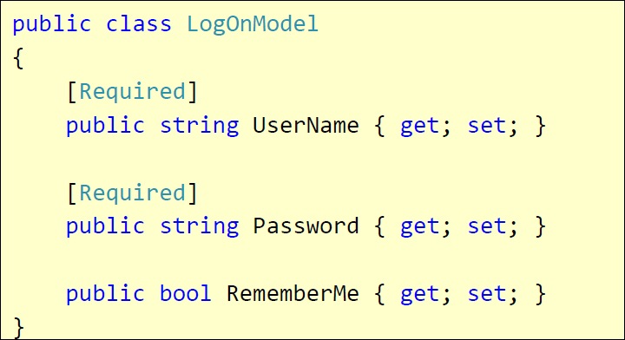
Validation with Annotations
Attributes are defined in
System.ComponentModel.DataAnnotations
Covers common validation patterns
Required
StringLength
Regex
Range

Slide 21
Data Validation Attributes
Attribute | Description
Required | Checks whether a non-null value is assigned to the property. It can be configured to fail if an empty string is assigned.
StringLength | Checks whether the string is longer than the specified value.
Compare | Checks whether two specified properties in the model have the same value.
Range | Checks whether the value falls in the specified range. It defaults to numbers, but it can be configured to consider a range of dates, too.
RegularExpression | Checks whether the value matches the specified expression.
CustomValidation | Checks the value against the specified custom function.

Slide 22
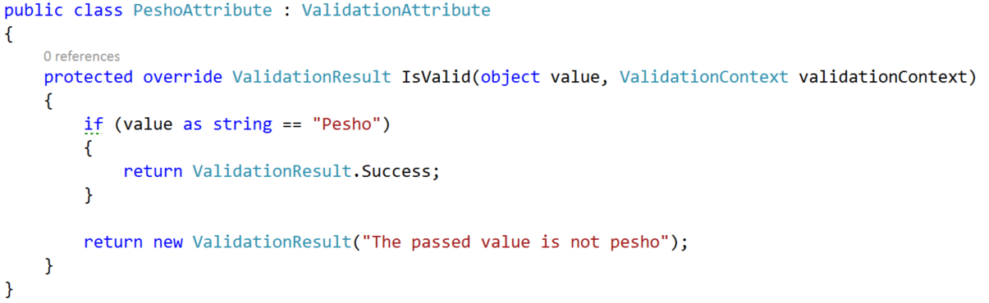
Custom Validation
Custom attributes
Inherit ValidationAttribute

Slide 23
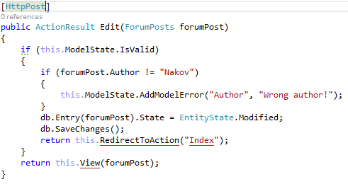
Validating Model – Controller
ModelState.IsValid will give us information about the data validation success
ModelState.AddModelError() will produce a custom error

Slide 24
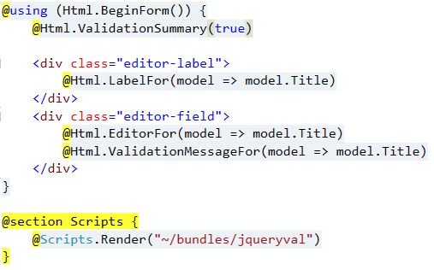
Validating Model – View
@Html.ValidationSummary() – output errors
@Html.ValidationMessageFor(…) – outputs validation message for specified property
Text box with integrated client-side validation

Slide 25
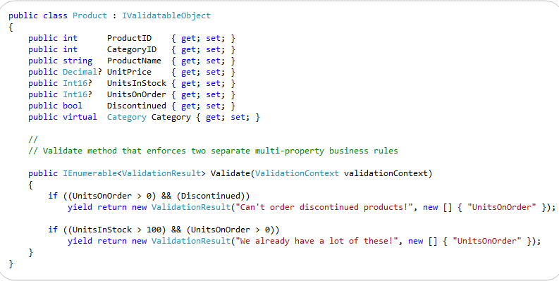
Class-Level Model Validation
Your model should implemented IValidatableObject

Slide 26
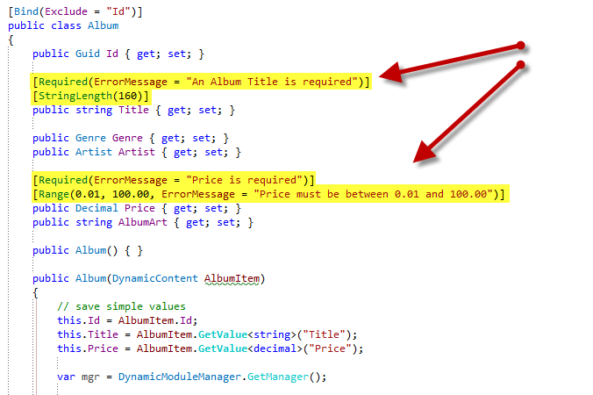
Other Annotations

Slide 27
Display / Edit Annotations
Attribute | Description
DisplayName | Friendly name for labels
DisplayFormat | Format strings and null display text
DisplayColumn | Specify the property of a model class for simple text display.
HiddenInput | Render value in a hidden input (when editing).
Bind | Tells the model binder which properties to include/exclude

Slide 28

View Components

Slide 29

Layouts
Views don't need to specify layout since their default layout is set in their _ViewStart file:
~/Views/_ViewStart.cshtml
Each view can specify custom layout pages
Views without layout:
@{
Layout = "~/Views/Shared/_UncommonLayout.cshtml";
}
@{
Layout = null;
}

Slide 30
Partial Views
Partial views render portions of a page
Reuse pieces of a view
Html helper – Partial
Razor partial views are still .cshtml files

Slide 31
Component Views
Component Views are made up from Class and Razor View
No Model Binding
Parameters do not come from the HTTP Request
Parameters are passed in @Component.Invoke() or InvokeAsync() Methods using C#
Allows us to have overloaded Invoke methods with different parameter types

Slide 32

Summary
Advanced Syntax
DI, Models, ViewBag, ViewData, TempData
Controls/Helpers
HTML Helpers, Tag Helpers
Model Binding & Data Validation
Request Data, ModelState
View Components
Partial Views , View Components

Slide 33








C# MVC Frameworks – Course Overview
https://softuni.bg/courses/asp-net-mvc

Slide 34
License
This course (slides, examples, demos, videos, homework, etc.) is licensed under the "Creative Commons Attribution-NonCommercial-ShareAlike 4.0 International" license

Slide 35





Trainings @ Software University (SoftUni)
Software University – High-Quality Education, Profession and Job for Software Developers
softuni.bg
Software University Foundation
http://softuni.foundation/
Software University @ Facebook
facebook.com/SoftwareUniversity
Software University Forums
forum.softuni.bg

